Slide 1
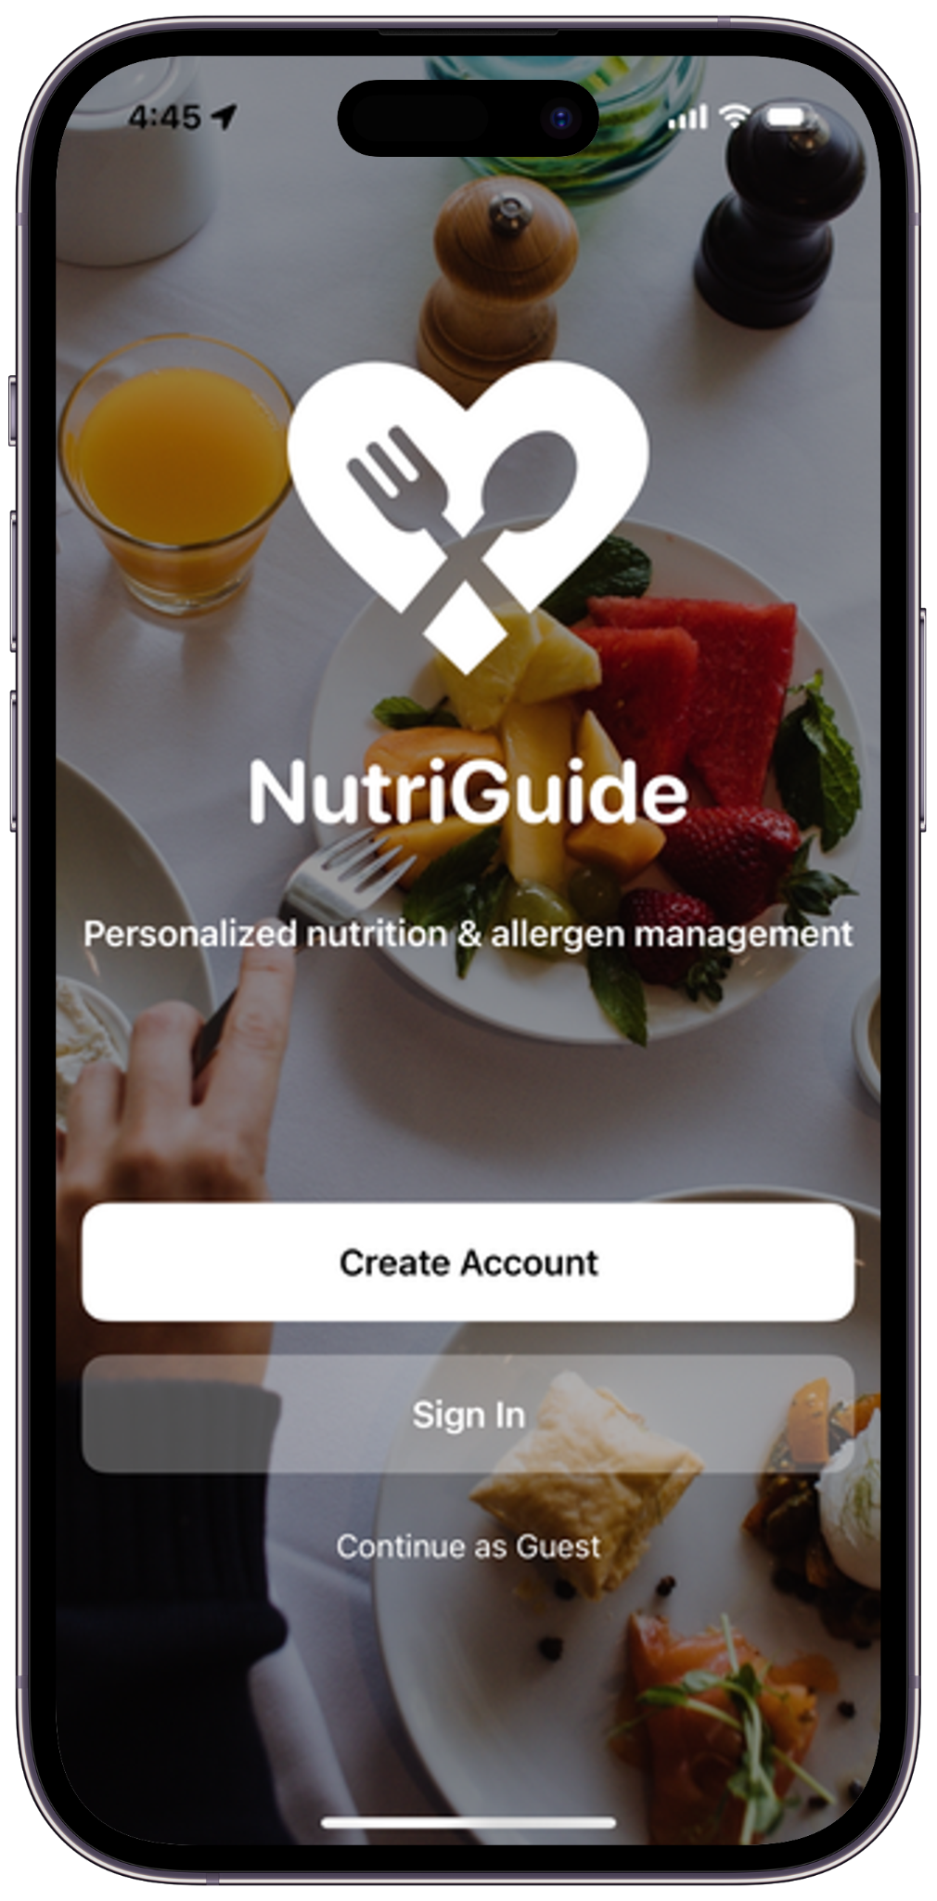
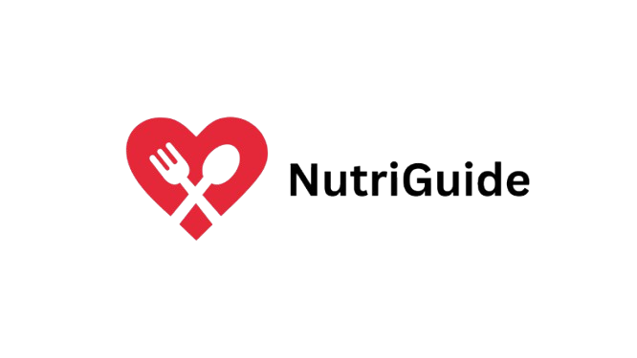

Slide 2
Table of contents
01
02
03
04
05
06
Problem Statement
Introduction
Architecture
Demo
Conclusion
Future Scope

Slide 3
01
Problem Statement

Slide 4
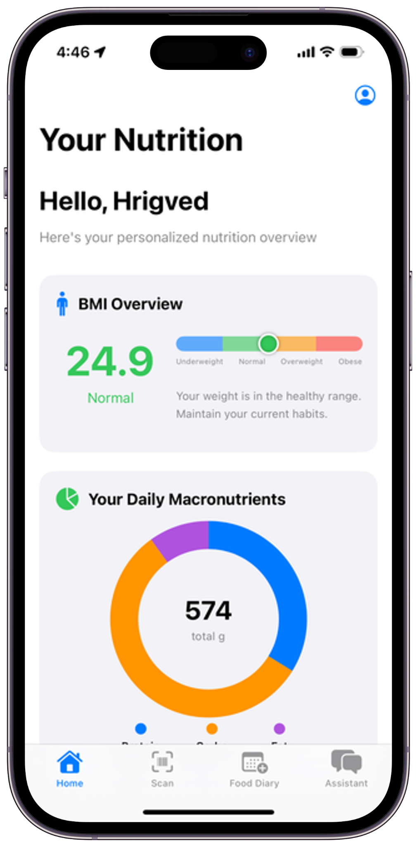
Millions of people struggle to manage allergies, dietary restrictions, and chronic health conditions while navigating daily nutrition. Today's apps lack personalized nutrition guidance, forcing users to manually cross-check allergens, decode
complex food labels, and guess their meals tailored for their health needs. This may lead to nutritional imbalances, increased stress, or, in some cases, emergencies. The absence of integrated tools for grocery decisions, nutritional support, meal planning, and emergency support calls for an app that handles
these situations effectively.

Slide 5
Introduction
02

Slide 6
Current Gaps
The apps on App Store today
Require users to manually search and enter the product from their database
Utilize AI to recognize a product (not accurate)
Do not provide nutrition support at fast food joints
And the most important thing: Do not take into consideration the allergies, conditions, dietary preferences and medications

Slide 7
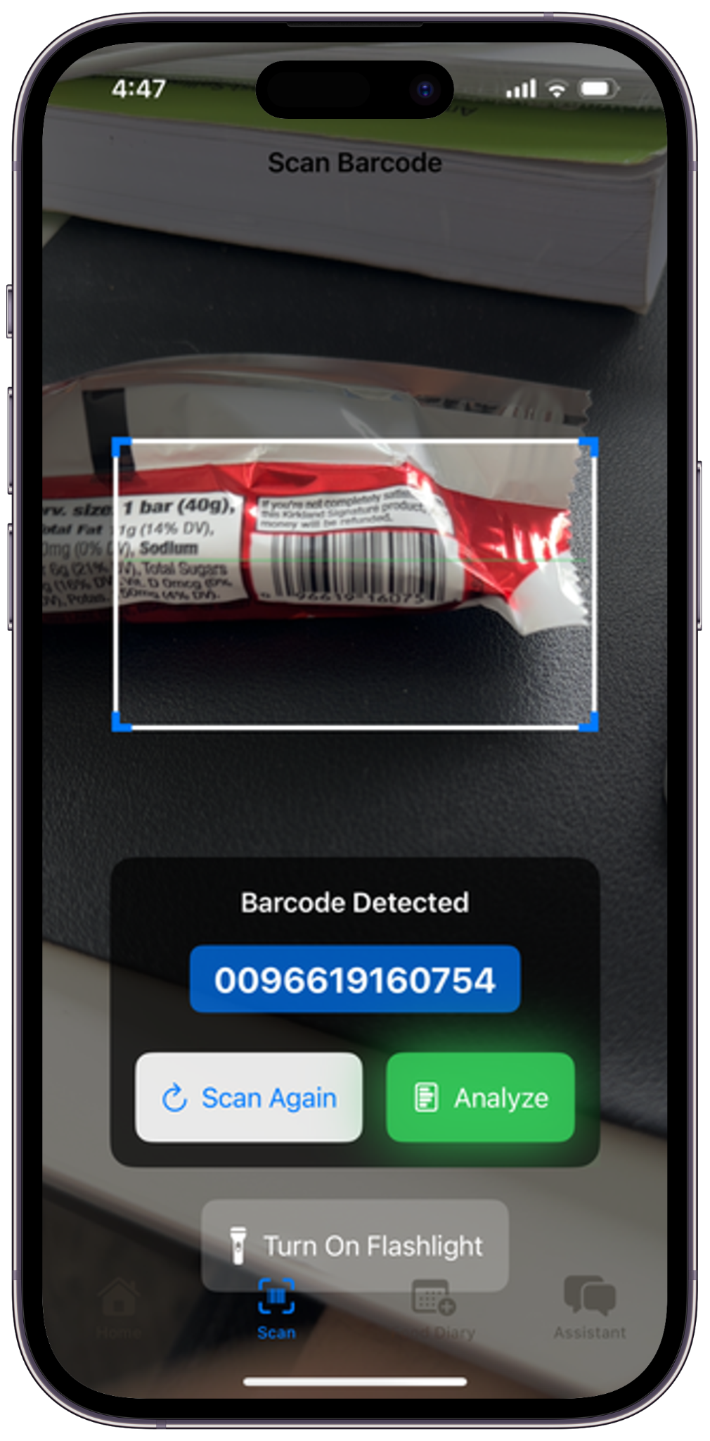
NutriGuide!
Uses Barcodes to scan a product and the AI analyzes the suitability. The AI assistant always helps to figure out whether a product - at a store or at a restaurant is suitable or not

Slide 8
Architecture
03
SwiftUI - AWS Cloud - Firebase

Slide 9
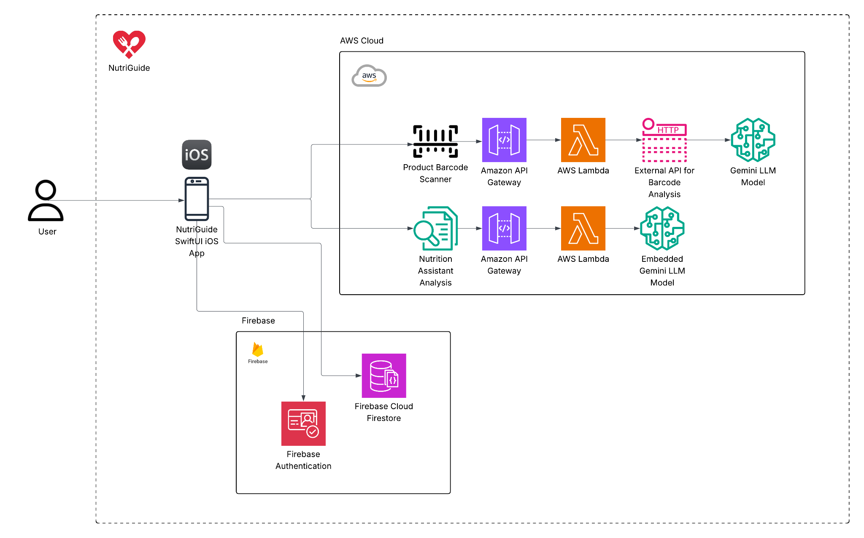
Architecture Diagram

Slide 10
04
Demo

Slide 11
Features
Health Report
Barcode Scan
Generates a Health Report, Emergency Card and Apple Watch connection
Scan the barcode and get AI results for suitability
Food Diary
Nutrition Assistant
Save time the next time you go grocery shopping
Confused at a fast food joint? Ask AI right away

Slide 12
Conclusion
05

Slide 13
Future Scope
05

Slide 14
Recipe Suggestions
Expanded Product Database
Greater product coverage
AI-powered meal planning
Product Comparison
Localization
Analyze multiple products
Additional language and regional food database

